Slide 1

DASI: Advanced Predictive Modeling Course and Scholarship of Teaching and Learning (SoTL) Kellie Keeling
DSI 22, Houston, TX, November 20, 2022
bit.ly/KKPresentationFiles
Notes:
8-9:30 AM Sunday, Session Title: Advanced Predictive Modeling Course and Scholarship of Teaching and Learning
Abstract: This session will explore an Advanced Predictive Modeling course with R balancing teaching programming versus the modeling techniques. The course reviews predictive and classification techniques including least squares regression, logistic regression, and trees as well as advanced concepts of support vector machines, neural networks, random forest and boosted trees, lasso/ridge regression, and GAMs. In addition, the presenter will discuss leveraging the reflections and changes that we make in courses to perform SoTL (Scholarship of Teaching and Learning) research.
Session Chair: Bob Andrews, Virginia Commonwealth University
Presenter: Kellie Keeling, University of Denver

Slide 2
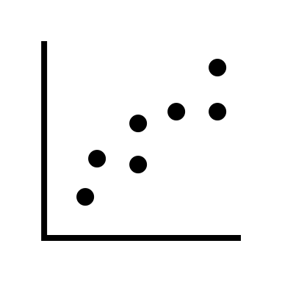

The Problem
When teaching a ”final quarter” Masters Predictive Modeling course I had concerns about modeling and coding knowledge
Haven’t you already had 1-4 classes on modeling (regression/classification models)?
Didn’t you have a programming course?
I decided to capture data and write up results for a research study.

Slide 3
Goals for Today
Balancing Programming/Coding and Advanced Predictive Modeling Topics
The Course (Topics Covered)
Approach to Programming
Study Results from Summer 22
BREAK
Scholarship of Teaching and Learning (SoTL)
Definitions
Motivation
Getting Started

Slide 4
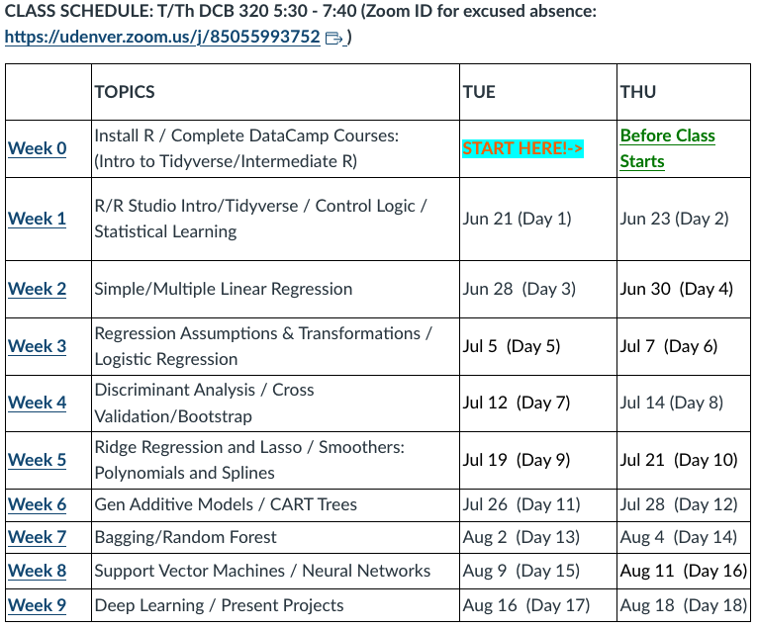
Adv Predictive Modeling with R
Typically Final Quarter of 4-quarter MSBA program
Most students have had
Business Statistics
Predictive Analytics
Data Mining/Viz
Text mining/social network)
Summer version 2h10m classes
Book: An Introduction to Statistical Learning with Applications in R

Slide 5
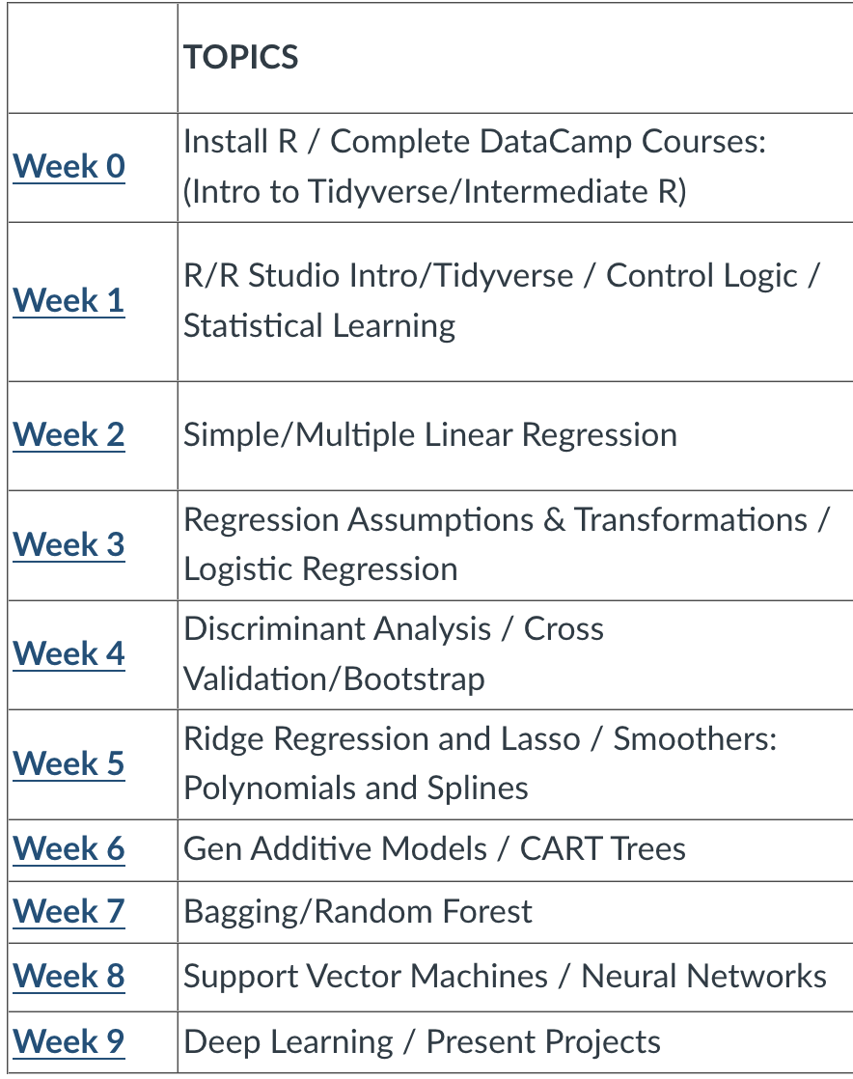
Adv Predictive Modeling with R
DataCamp, Intro to R, Programming Reminders, Visualizing Data
Regression Reminders
Classification Reminders/Logistic/Trees
New Topics: Cross Validation, Ridge/Lasso, GAMS, Bagging, RF, SVM, NN, Deep Learning

Slide 6
Approach to Programming DataCamp www.datacamp.com/ groups/classrooms
Start with 2 DataCamp courses (assign week before class and due end of first week)
Introduction to the Tidyverse
Data Wrangling
Data Visualization
Grouping and Summarizing
Types of Visualizations
Intermediate R
Conditionals and Control Flow
Loops
Functions

Slide 7
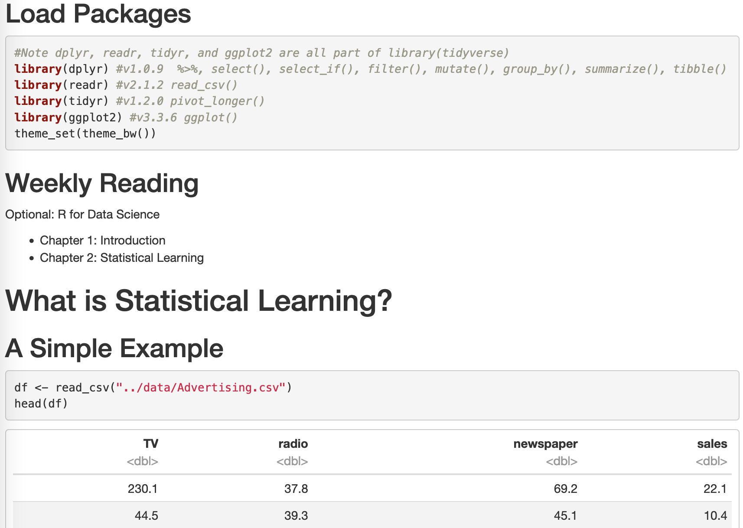
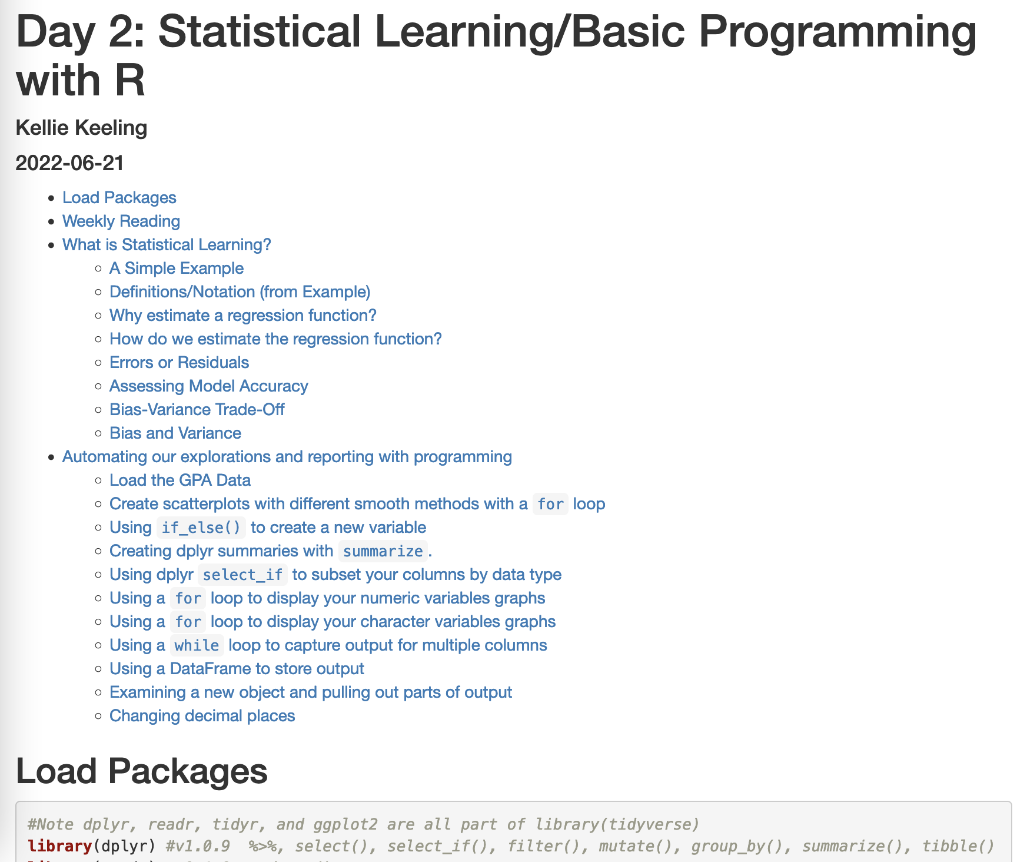
Class Notes
Rstudio – Rmarkdown to create .html files

Slide 8
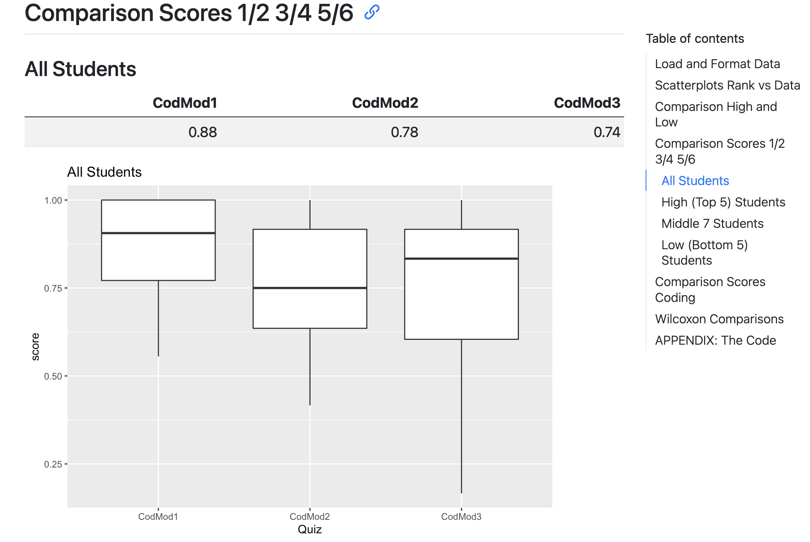
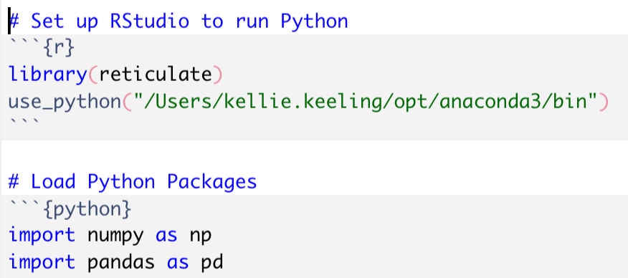
Class Notes
UPDATE: Winter – will be using Quarto instead of R Markdown
Table of contents can stay visible
May try to add Python code examples!!??

Slide 9
Class Notes
After the first week, I don’t focus on “programming”, but I motivate understanding of “programming” by
including functions and loops to automate
the modeling process
capturing/formatting results

Slide 10
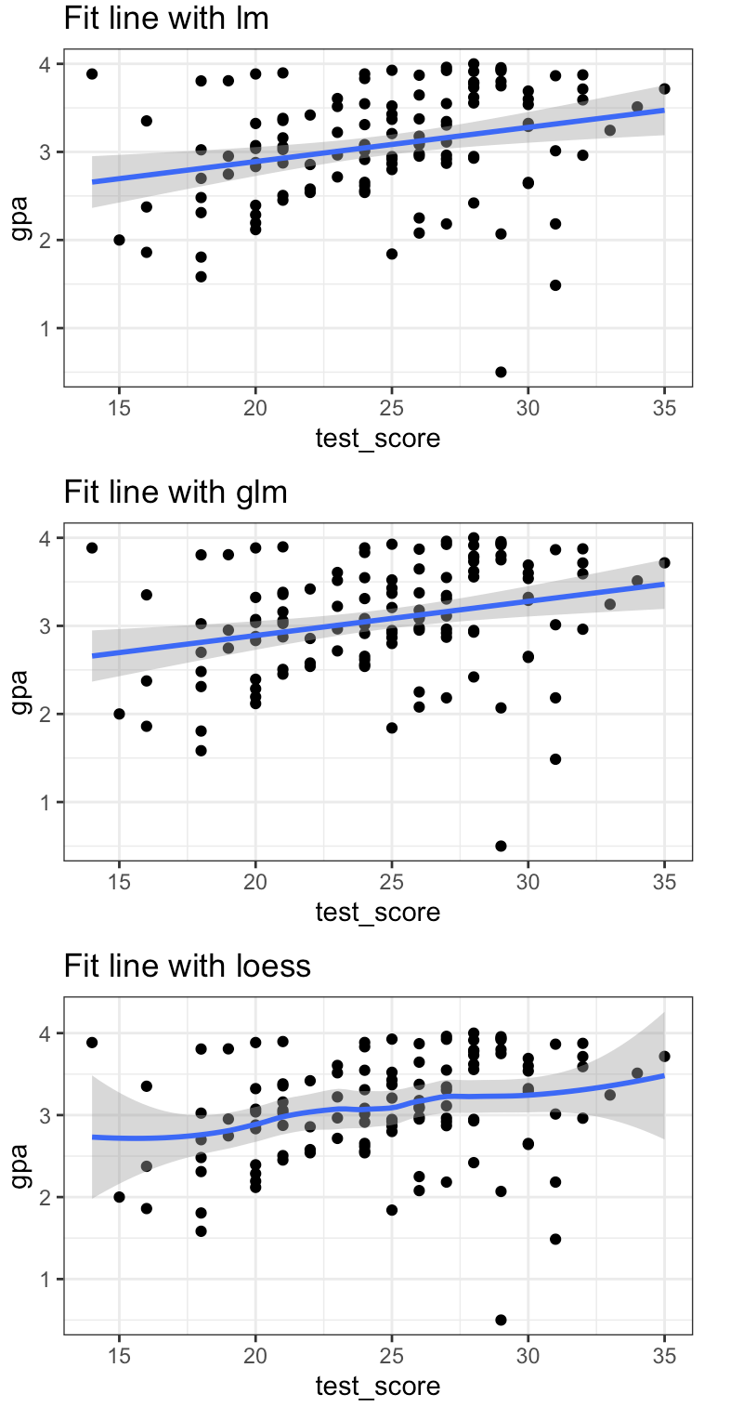
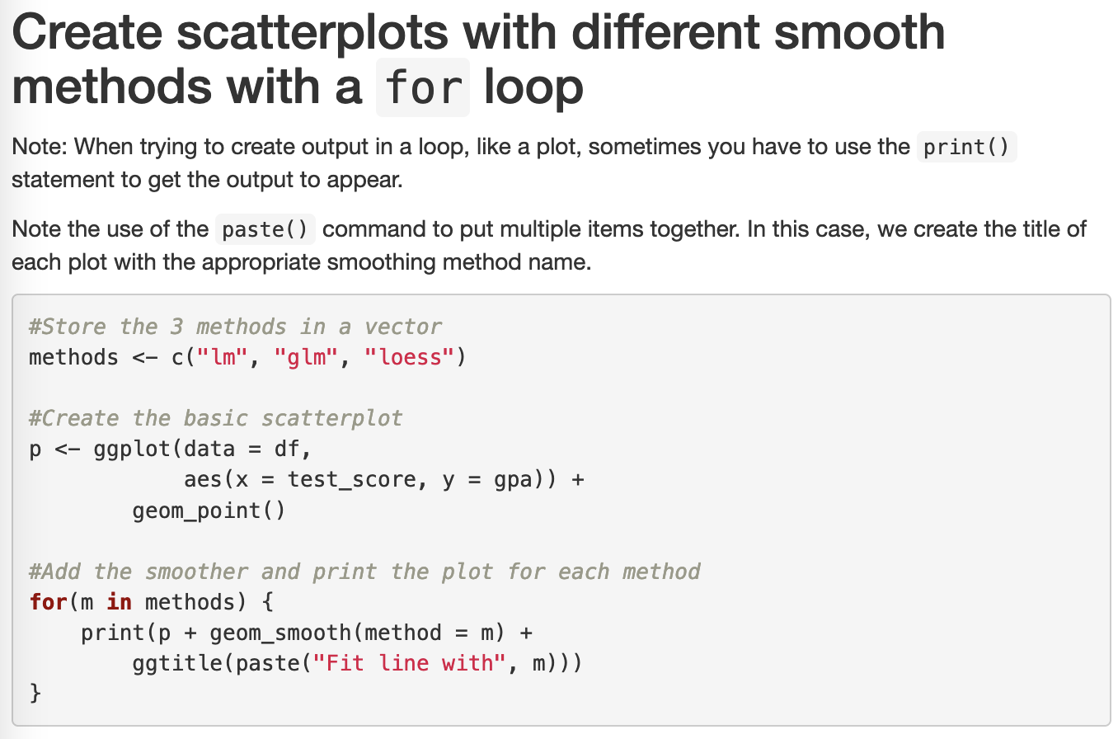
Notes:
In First class assignment, have create these 3 plots. Second class, go over looping code and “redo” plots so now in a loop.

Slide 11
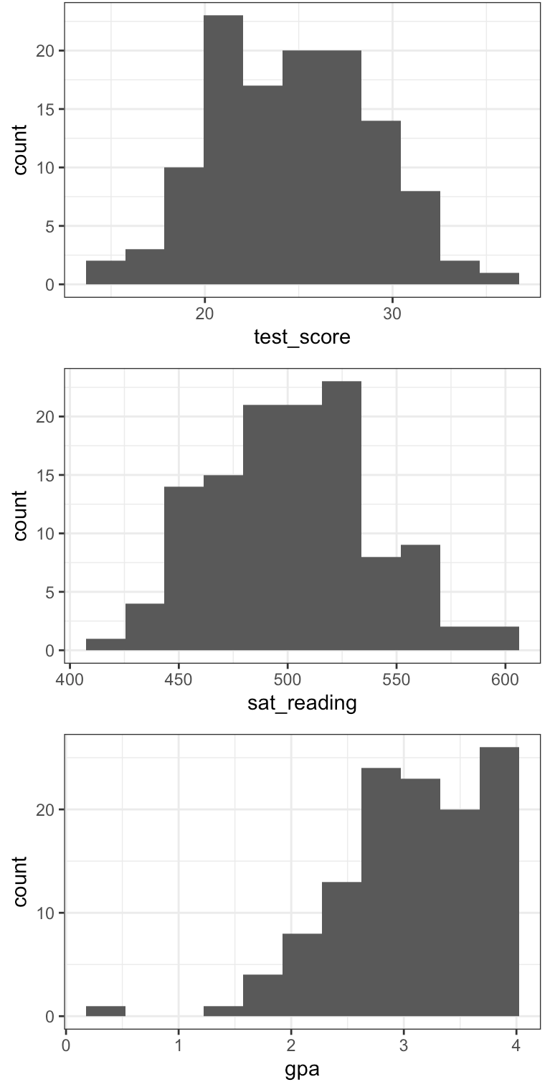
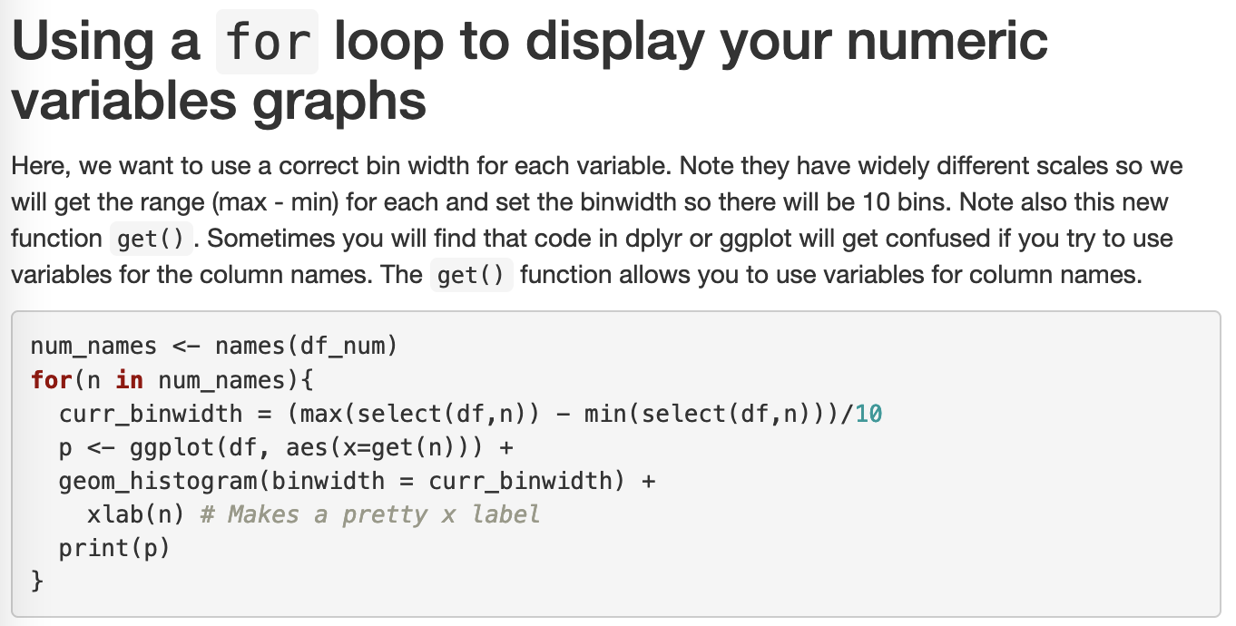
Notes:
Write this code 3 times or use a loop

Slide 12
Research Study
Feeling: Top and low performing students don’t advance in skills throughout the course in the same rate.
Experiment: R&R (REV UP and REWIND)
 | Class taught without R&R Sum 22 | Class taught with R&R Win 23 | Class taught with R&R and Personal Feedback Sum 23
Coding Concepts (3 quizzes) | 1 | 3 | 5
Modeling Concepts (3 quizzes) | 2 | 4 | 6
Additional Analysis across groups:
High, Middle, Low Class Rank
First, Second, and Third Quizzes

Slide 13
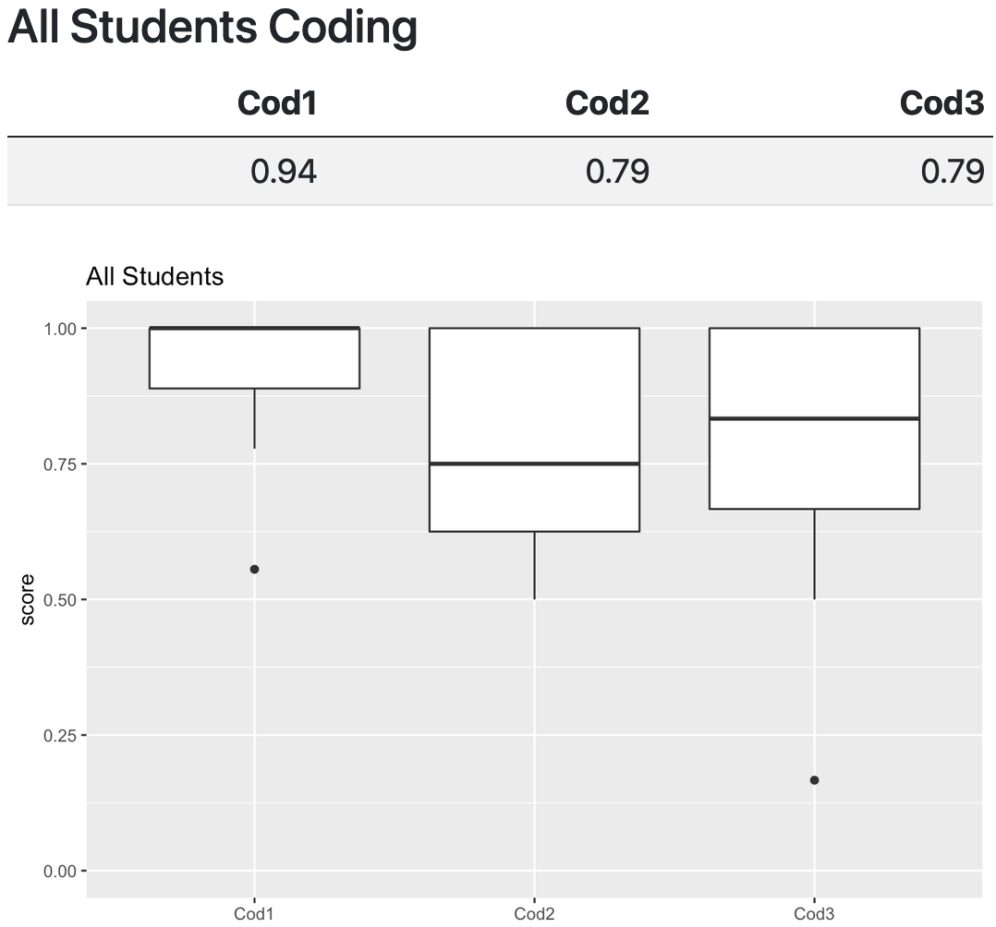
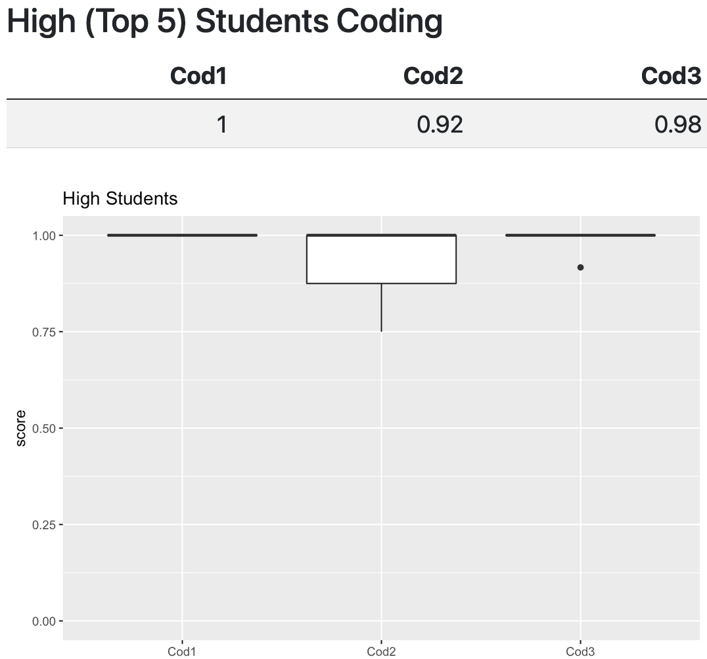
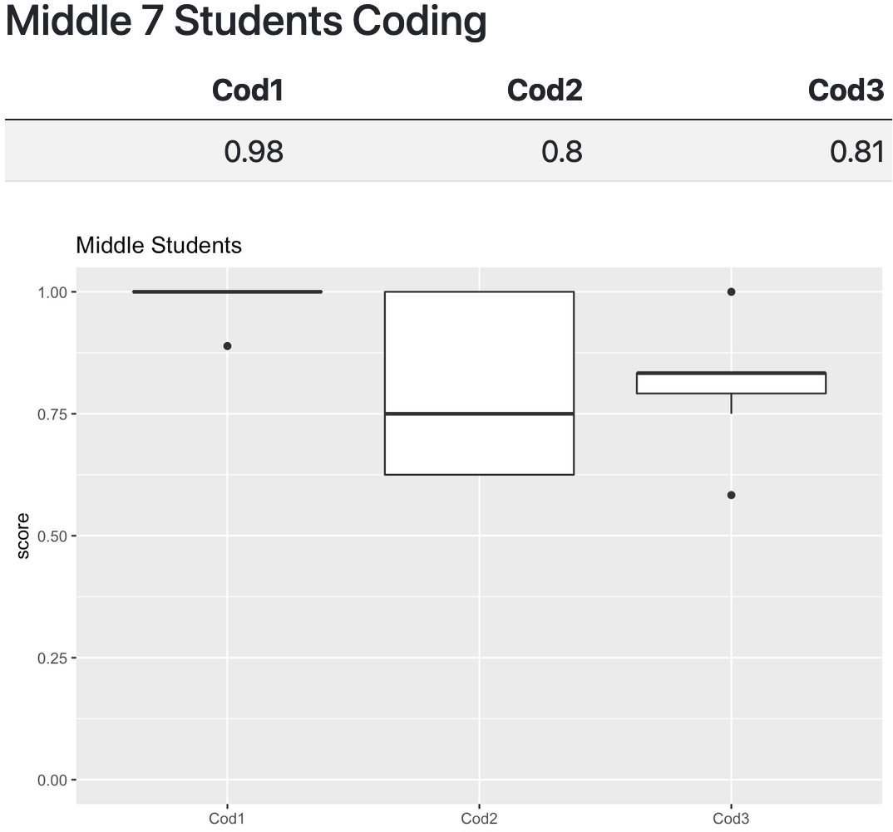
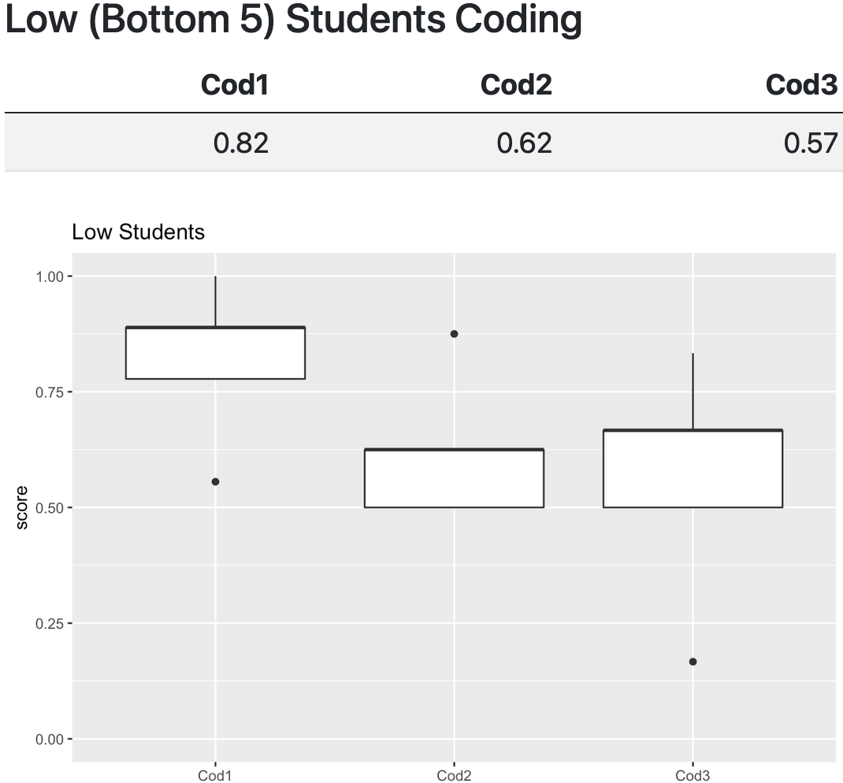
Coding Quizzes
1: recognizing basic coding structures (if/then/else and loops)
2 and 3. focus on your ability to use basic coding structures (if/then/else and loops), variables, comparisons, arrays, and functions

Slide 14
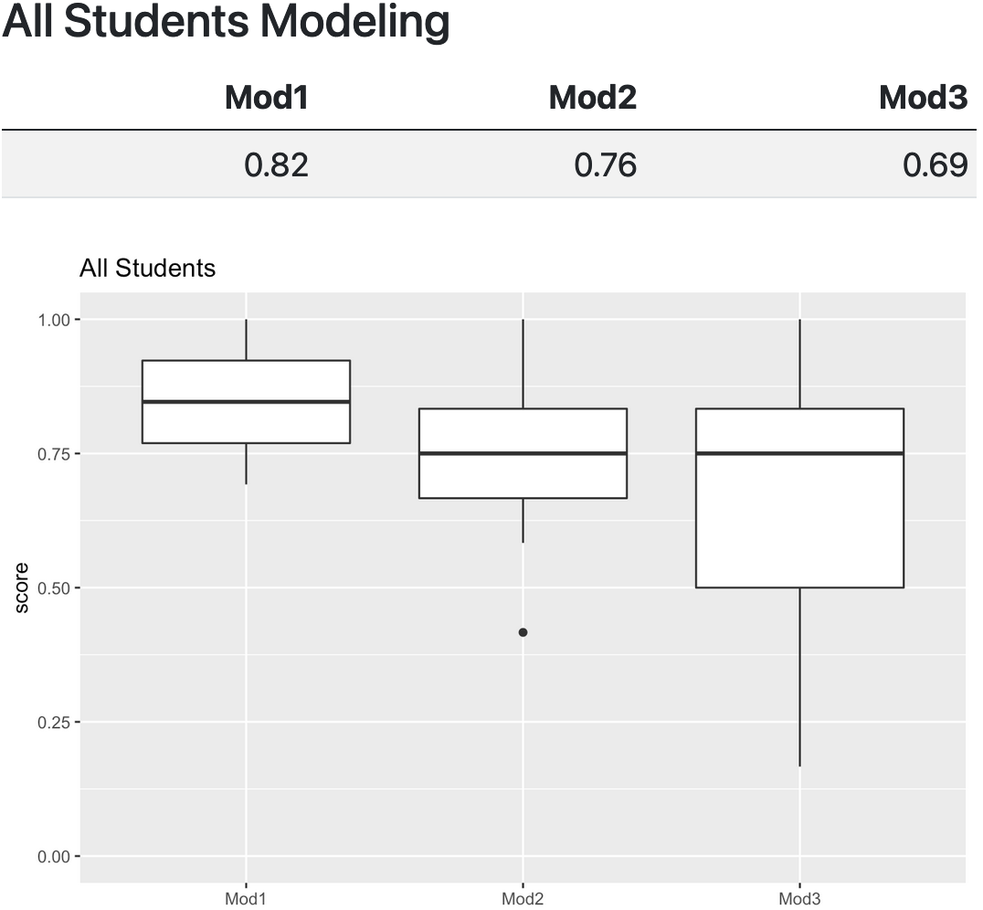
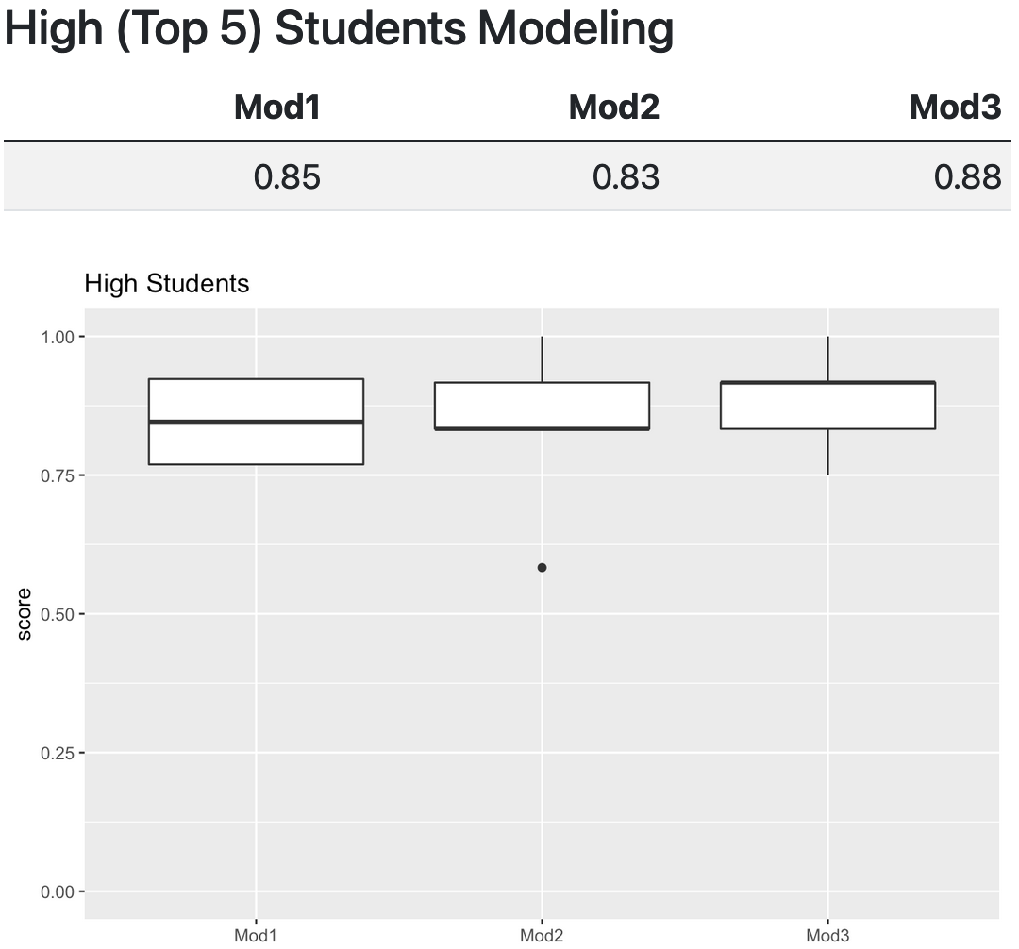

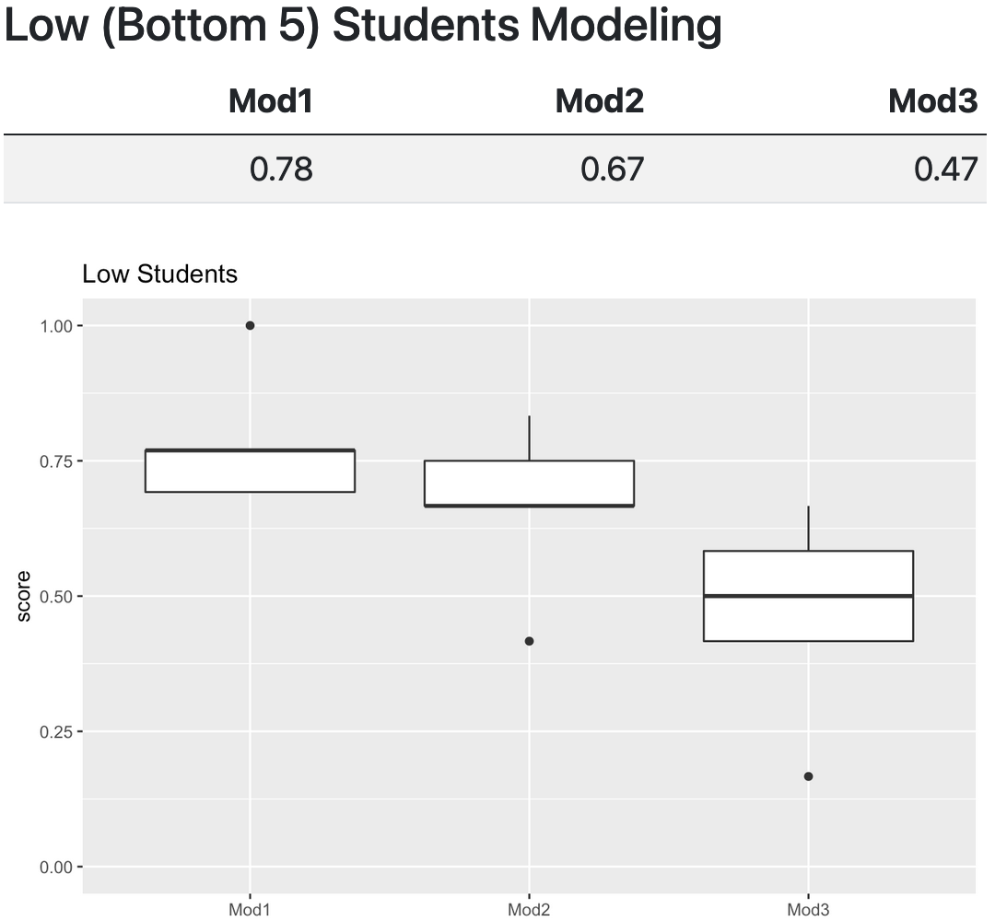
Modeling Quizzes
1. Regression Models
2. Classification Models (Logistic)
3. Revisit the topics of Least Squares Regression and Classification models
Notes:
1. Least Squares Regression - coefficients, R^2, MAE, actual versus predicted plots, Overall F, residuals, multicollinearity, interaction/non-additive terms, and qualitative predictors
2. Classification - cover basics around performing classification models (confusion matrices, accuracy, error rate, sensitivity, specificity, ROC Curves, AUC, and interpreting logistic modeling output (significant coefficients, what a positive vs negative coefficient means, and logit vs probability (any formulas will be provided)).
3. Revisit the topics of Least Squares Regression and Classification models

Slide 15
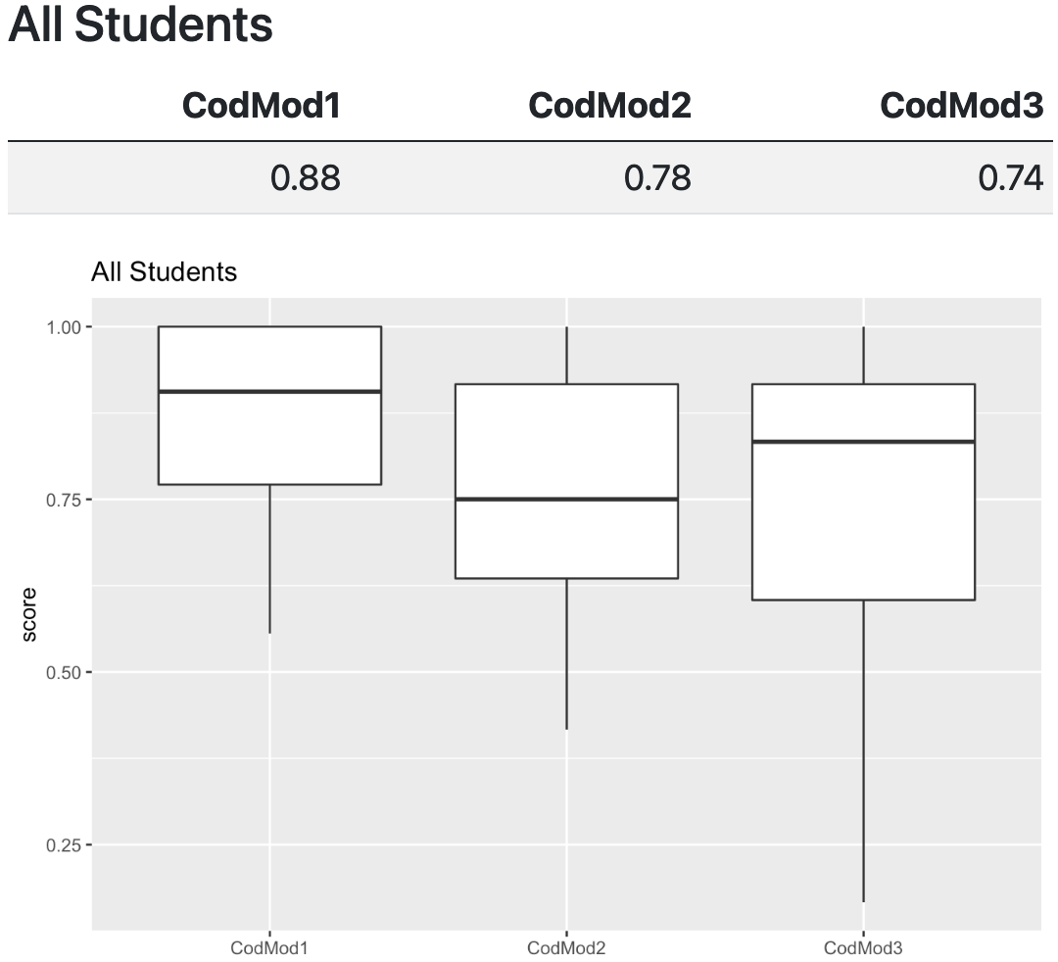
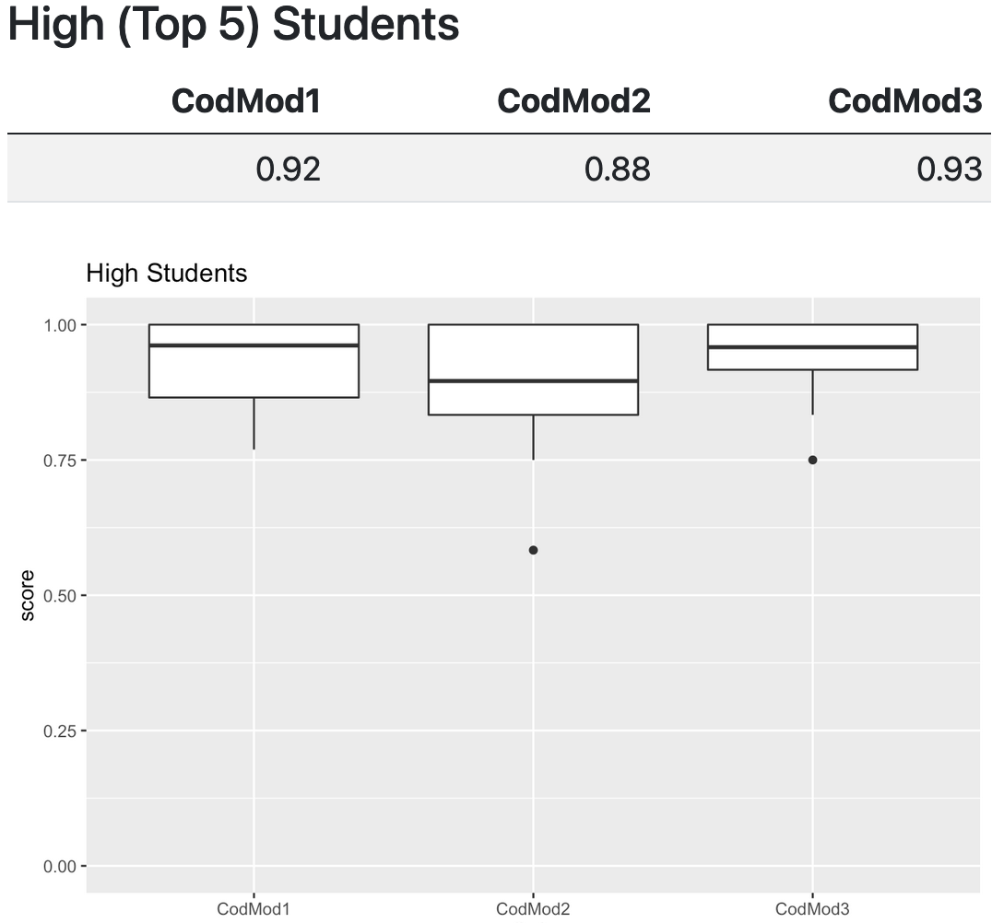
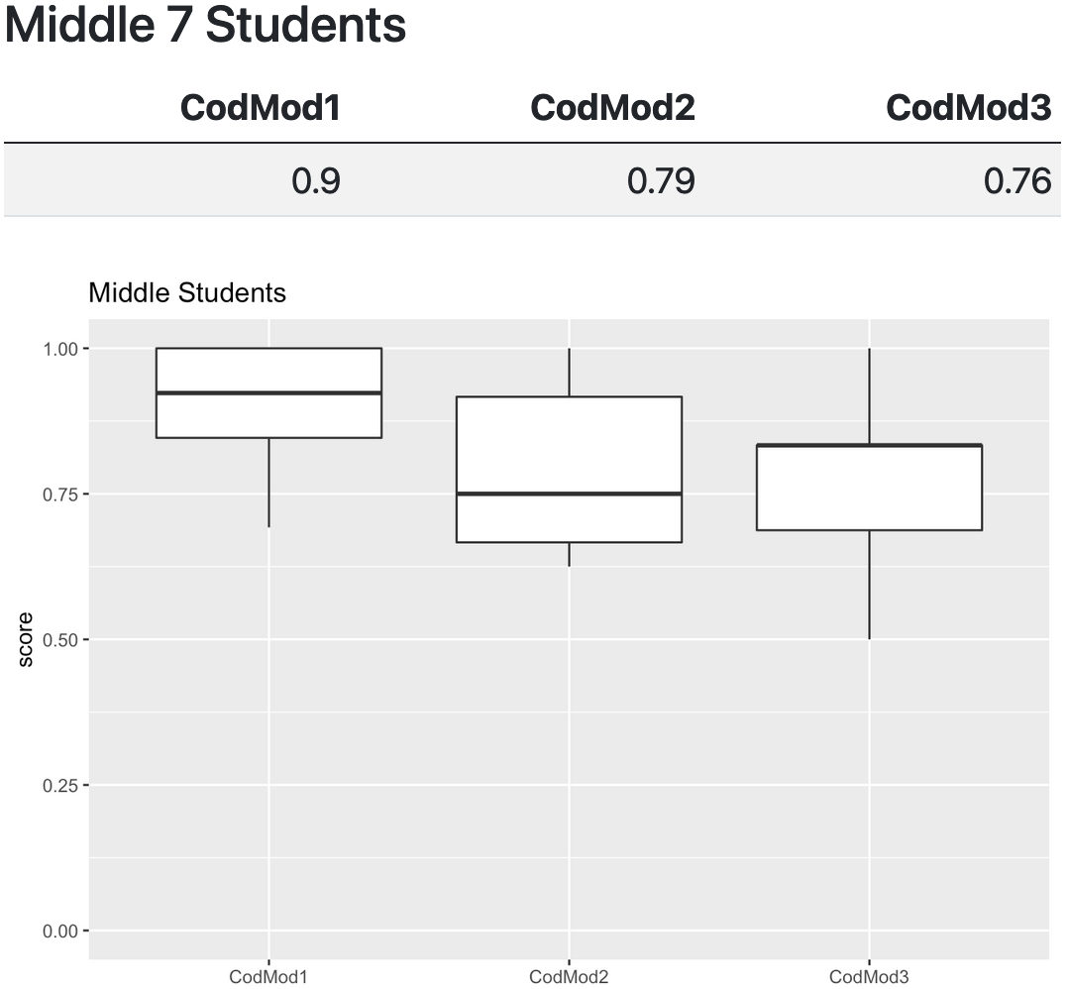
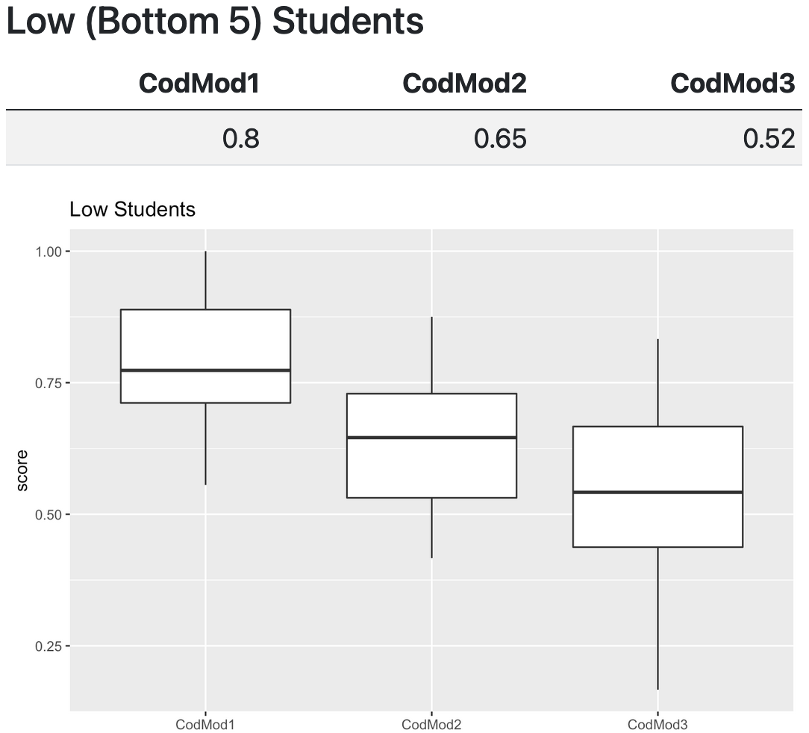
Coding/Modeling Quizzes
Combining 1st, 2nd, and 3rd quizzes
Notes:
if_else(course_rank <=5,'High',
if_else(course_rank >=13,'Low','Middle'))

Slide 16
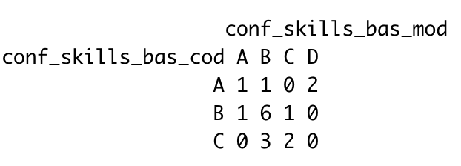
Student Comments
The final quiz included self-reflection questions on their confidence in coding and modeling concepts.
A=very confident B=conf C=somewhat conf D=neutral E=not conf
Modeling Confidence
Coding Confidence

Slide 17
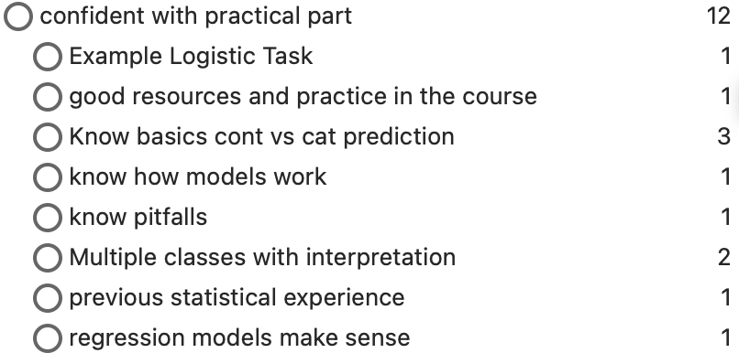
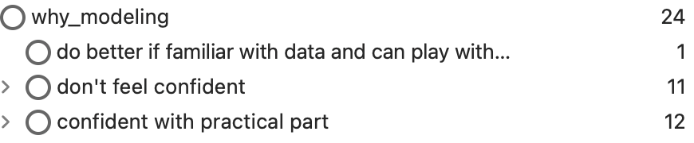
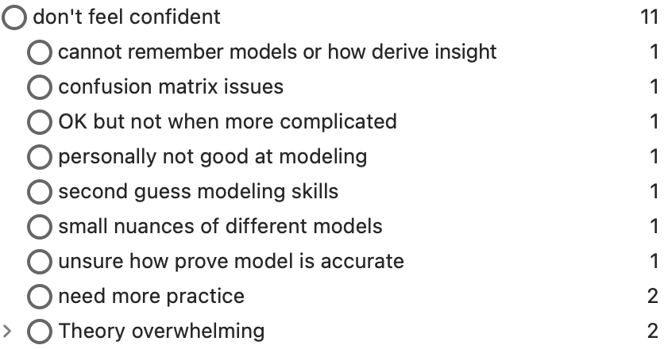
Student Comments
Modeling Confidence

Slide 18
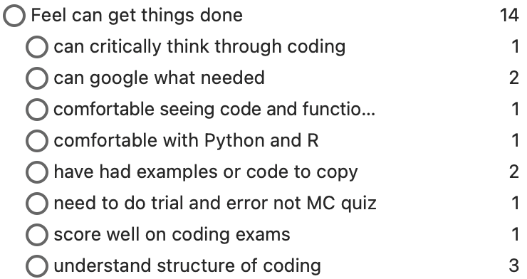
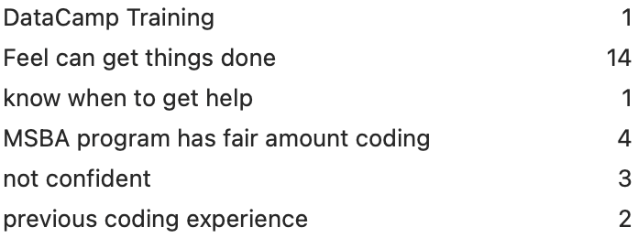
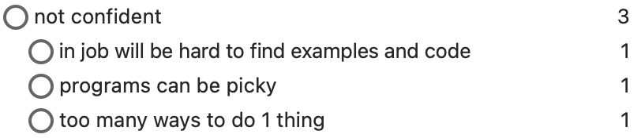
Student Comments
Coding Confidence

Slide 19
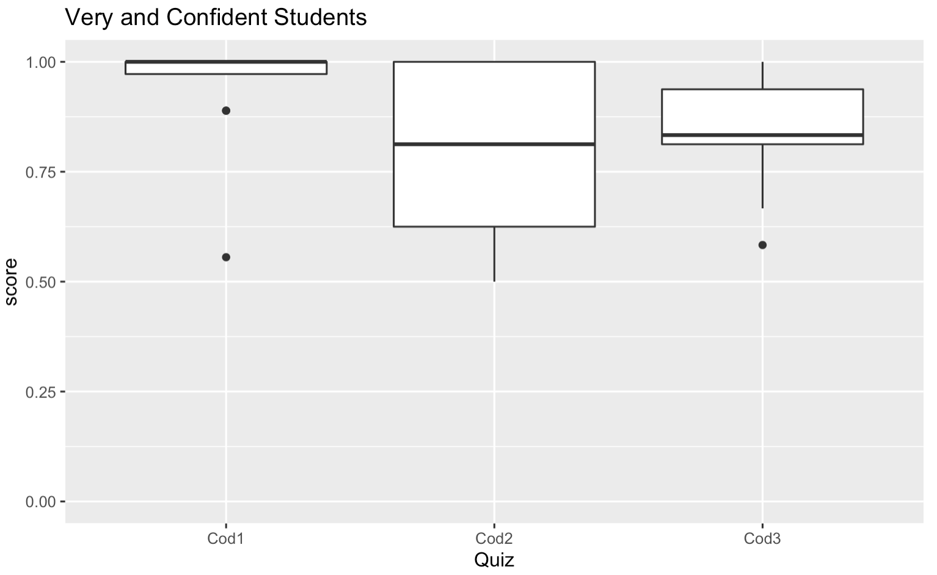
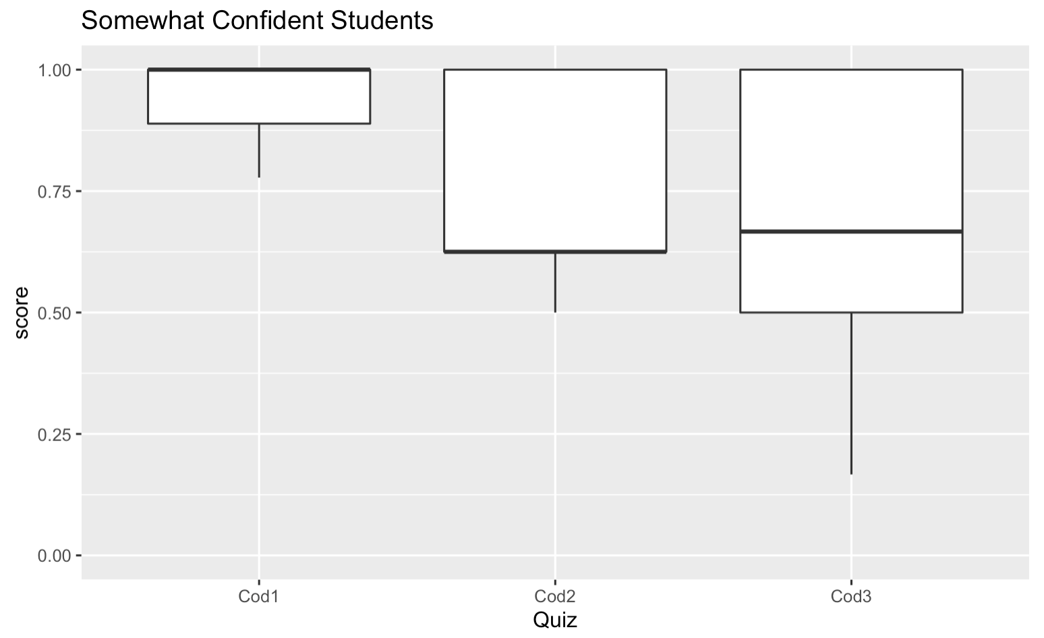
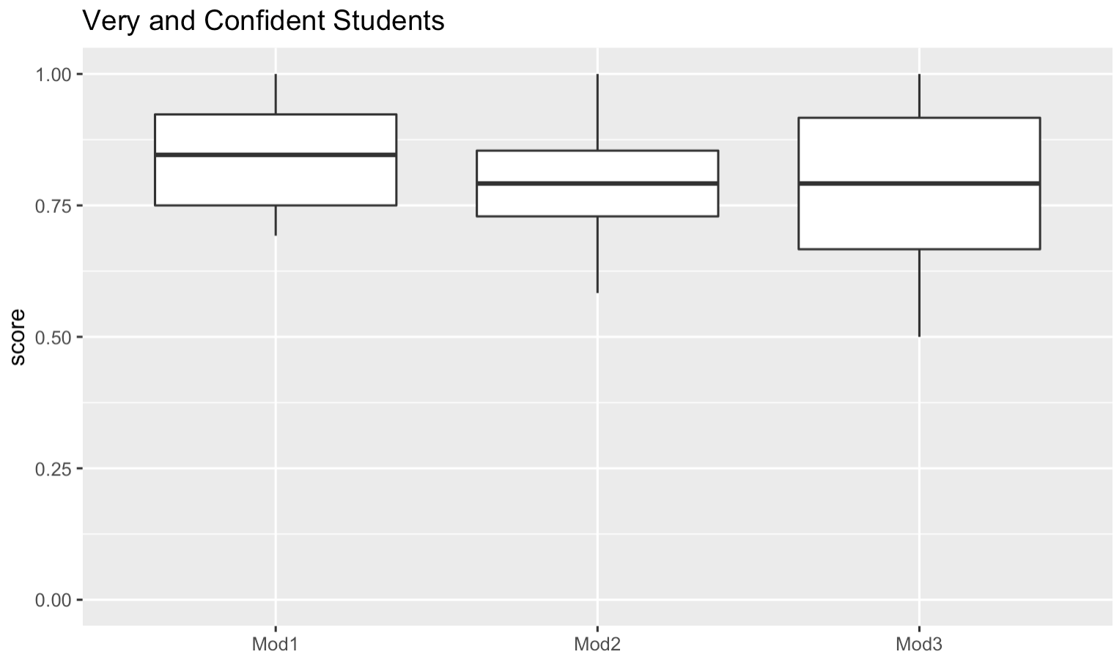
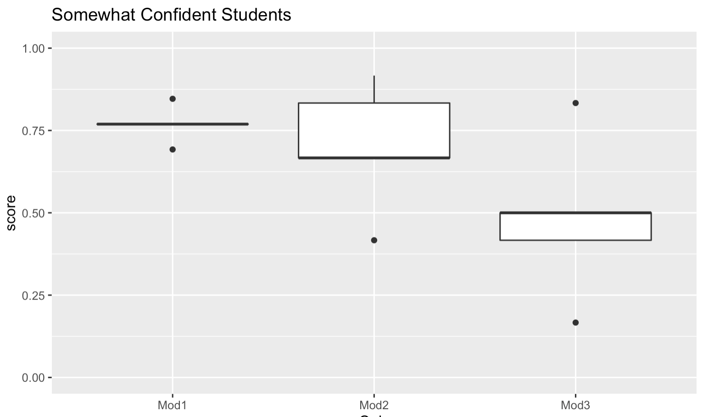
Confident?
Coding
Quizzes
Modeling
Quizzes

Slide 20
Limitations/Future
This contained data from a single course of only 17 students
The quizzes will be continued in Winter and Summer and I will examine adding some REWIND/REVUP assignments to help review these concepts in the Winter.
REWIND – practice concepts
REVUP – build upon concepts – if feel comfortable with basics

Slide 21
PAUSE

Slide 22
?s From ESTL ‘12
Why did this teaching strategy (activity, lecture, discussion, etc.) work or not work?
Why did it or did it not achieve the intended outcome(s)?
What information (e.g., exam scores, student writing) will I need to determine whether the teaching strategy achieved the intended outcome(s)?
Once I have the information, how can I use it to determine whether the teaching strategy was effective?
How, when, and with whom will I share my experiences?

Slide 23



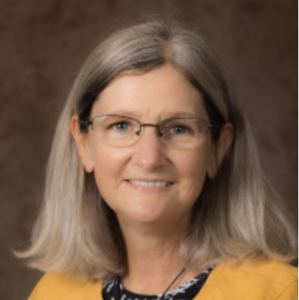
Resources
Kayoung Kim
DU Director of Scholarship of Teaching and Learning & Faculty Learning Communities
Aaron S. Richmond
Metropolitan State University of Denver
ESTL ‘12

Slide 24
What is the Scholarship of Teaching and Learning (SoTL)?
Scholarly Teaching - Teaching that entails certain practices of classroom assessment and evidence gathering; teaching that is informed not only by the latest ideas in the field but by current ideas about teaching generally and specifically in the field; and teaching that invites peer collaboration or review (Indiana University Bloomington SoTL tutorial).
Scholarship of Teaching - Work on teaching that is public, is critically peer reviewed and evaluated, and used and on by colleagues.
Aaron Richmond

Slide 25
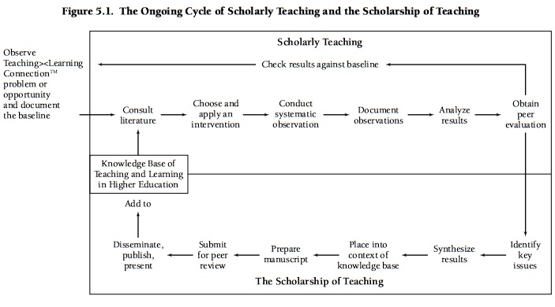
Aaron Richmond – Figure by Laurie Richlin

Slide 26
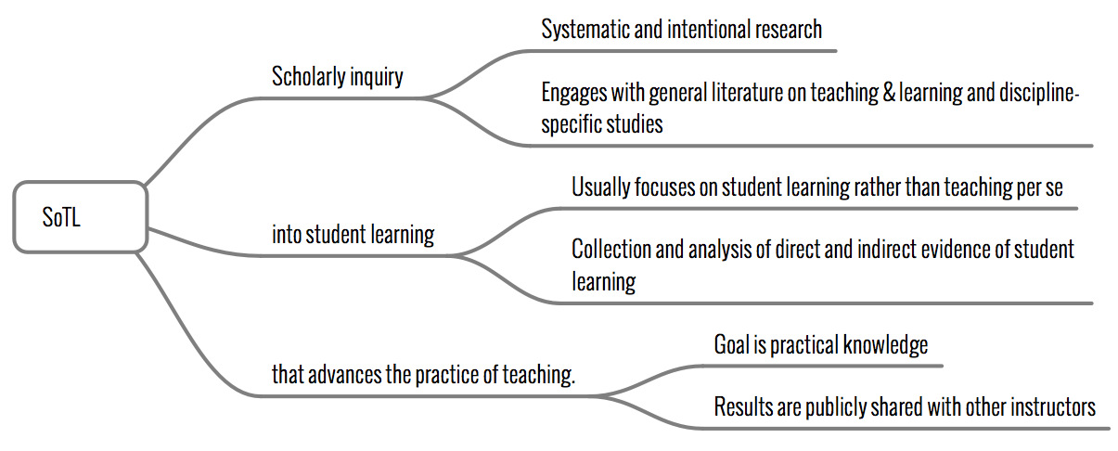
What is SoTL?
Aaron Richmond

Slide 27
Categories of SoTL
The first, wisdom-of-practice scholarship, includes the experiences of teachers. Examples of wisdom-of-practice scholarship are
personal accounts of change
recommended practices reports
recommended content reports
personal narratives.
The second, research scholarship, varies widely but can include quantitative investigations, qualitative studies, and descriptive research.
Weimer (2006)
ESTL ‘12

Slide 28
5 Genres of SoTL
1. Reports of particular classes include essays of “expert knowledge” about what worked.
2. Reflection on several years of teaching, informed by other SoTL work includes
essays developing good ideas
summaries of expert knowledge gained by self-reflection and experimentation
integration of larger frameworks into classroom and curriculum practice.
3. Larger Contexts: Comparison of Courses and Comparisons of Student Change Across Time (qualitative and quantitative changes)
4. Learning Science refers to the body of work that exists in human and animal learning.
5. Summaries and Analysis of Sets of Prior Studies
Craig Nelson (2003)
ESTL ‘12

Slide 29
My SoTL Journey
“Does Your iPod Have a Soul? The Generation of Random Numbers,"
Decision Sciences Journal of Innovative Education, Vol. 5, No. 1, Jan 2007, pp. 169 – 177.
Responses from 12 Authors to the Article on 'Do Business Schools Have a Role in the Current Financial Crisis?’.
Decision Sciences Journal of Innovative Education, 2009, 7(2), 340-341.
Employing Introductory Statistics Students at 'Stats Dairy’.
Teaching Statistics: An International Journal for Teachers, 2011, 33(3), 78-80.
iTeaching: Using an iPad to Go Green While Supporting Teaching Efficiency.
Business Education Innovation Journal, 2012, 4(2), 44-49.

Slide 30

Engaging in SoTL - 3 Main Benefits
Improves student learning because
it affects how faculty members think about teaching and learning opportunities for their students.
Contributions to the field of teaching are improved and enhanced.
Enriches one’s experiences as a teacher
Chism (2008)
ESTL ‘12

Slide 31
Triple Dip!!
An opportunity to triple-dip
Service
Research
Teaching
Improve Your Department and Institution
Aaron Richmond
Notes:
Let’s look at how to get started next.

Slide 32
Designing Your Study Worksheet (ESTL 12)
State your research question.
Identify the type of methodology you will use: qualitative, quantitative, or both.
Will you do a pilot study?
Identify your time frame.
Identify the groups you will study.
Identify the approaches you will use.
Qualitative Methods (Descriptive, Case Study, Observation, Interview, Focus Group)
Quantitative Methods (Survey, Experiment, Quasi-Experiment)
Draw your research design/describe your research approach.
Observation Treatment Observation
Notes:
Question: Do students who use extra materials improve their understanding of coding concepts
Methodology – mostly quantitative 3 quizzes with small qualitative reflection
Time Frame – 2 quarters
Groups – multiple semesters
Approaches – survey of experiences and quasi-experiment

Slide 33
Steps to SoTL Publication
1. Generate research purpose
Determine your research question(s) through literature review
2. Select research design and methodology and submit IRB
Be sure your CITI certification is up-to-date, and submit research proposal to IRB
Target a particular conference or professional journal
Keep deadlines, intended audience, and any other requirements in mind while conducting and writing up your research.
3. Begin data collection (AFTER IRB approval and participant consent (if applicable))
4. Analyze and interpret data, write up results
5. Discuss results through the study's findings, limitations, and implications for future research
6. Submit study to conference or journal in required manuscript format
Modified from https://portfolio.du.edu/sotl/page/69971

Slide 34




Where can I publish?
SoTL Journals
ASA
Education
Department
Kennesaw State SoTL Resources: Directory of Journals:
https://facultydevelopment.kennesaw.edu/scholarly-teaching/journals/index.php

Slide 35
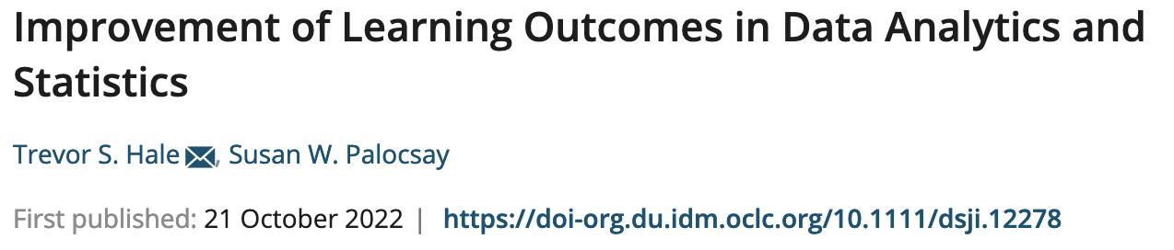
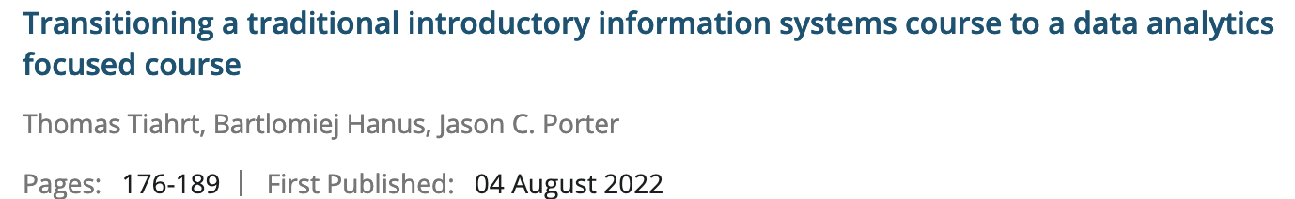
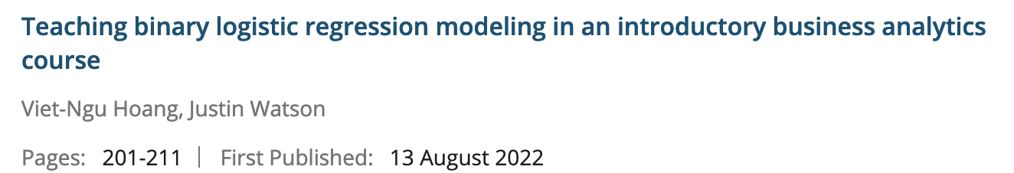
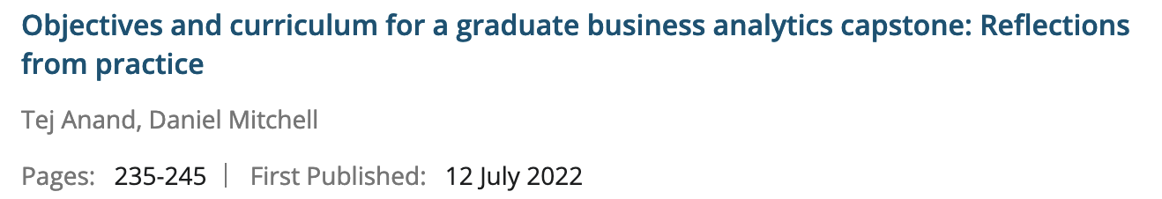
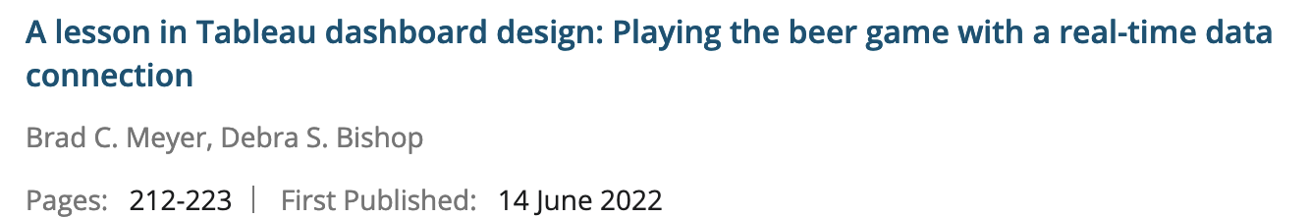

Slide 36
Where can I publish?
SoTL Conferences
Directory of Conferences and SoTL Resources
Kennesaw State: https://facultydevelopment.kennesaw.edu/scholarly-teaching/conferences/index.php
Illinois State: https://sotl.illinoisstate.edu/conferences/
International Society for the Scholarship of Teaching and Learning: issotl.com
Lilly Conference on College and University Teaching
EDUCAUSE https://www.educause.edu/
Lots of Regional Conferences

Slide 37
REFERENCES
Dietz-Uhler and Bishop-Clark (2012), Engaging in the Scholarship of Teaching and Learning: A Guide to the Process, and How to Develop a Project from Start to Finish, Stylus Publishing
Chism, N. V. N. (2008, April). The scholarship of teaching and learning: Implications for professional development. Key presentation at the Thai Professional and Organizational Development (POD) Network 2-Day Workshop, Bangkok, Thailand.
Weimer (2006). Enhancing scholarly work on teaching and learning. International Journal for the Scholarship of Teaching and Learning, 2 (1), 1-6.
Craig Nelson (2003). Doing It: Examples of several of the different genres of the scholarship of teaching and learning. Journal on Excellence in College Teaching, 14 (2 & 3), 85-94.
DU Office of Teaching and Learning (otl.du.edu and https://portfolio.du.edu/sotl/page/69971)
Kayoung Kim
Aaron Richmond, Metropolitan State University of Denver

Slide 38



Thank You!
Kellie Keeling DU Hiring: KKeeling@du.edu Assoc/Full Professor of
Business Info & Analytics
Thank You!
bit.ly/KKPresentationFiles

